Slide 1
REAL-TIME DRIVER DROWSINESS DETECTION USING DEEP LEARNING
NAME: SAIKIRAN DAMALLA
COM748 MSc Project
SUPERVISOR: MUHAMMAD ALTAF
UNIVERSITY: ULSTER UNIVERSITY, LONDON

Slide 2
CONTENTS
Title Slide
Contents
Introduction
Problem Statement
Existing Methods
Research Gap
Proposed System
System Workflow
Dataset Preparation
Data Annotation
Augmentation
YOLO Model
Technologies Used
Results
Contribution
Limitations
Future Work
Conclusion

Slide 3
INTRODUCTION
Road accidents are a major global issue.
Driver drowsiness is a key contributing factor.
Drowsiness reduces attention, slows reaction time, and impairs decision-making.
Real-time detection is essential for improving road safety.
Driver fatigue significantly increases accident risk because it reduces attention and reaction time, making it a serious but often unnoticed problem

Slide 4
PROBLEM STATEMENT
Drowsiness is difficult to detect early.
Drivers may experience microsleep episodes.
Traditional systems fail to detect real-time fatigue.
Need for a fast and accurate detection system.
Drivers may experience microsleep for a few seconds, which is enough to cause serious accidents. Detecting this in real-time is the main challenge.

Slide 5
EXISTING METHODS
Physiological methods (EEG, ECG) are accurate but intrusive.
Vehicle-based methods detect drowsiness too late.
CNN models provide high accuracy but require high computation.
Not suitable for real-time applications.
Although these methods exist, they are either intrusive, slow, or not suitable for real-time applications.

Slide 6
RESEARCH GAP
Existing systems focus mainly on accuracy.
Lack of optimization for real-time deployment.
High computational complexity.
Poor robustness under real-world conditions.
This project addresses these limitations.
Existing systems focus mainly on accuracy but ignore real-time performance and efficiency. This project addresses that gap.

Slide 7
PROPOSED SYSTEM
YOLO-based deep learning model.
Detects driver state as Normal or Drowsy.
Performs detection in real time.
Efficient and low-latency system.
The system uses YOLO to detect driver state directly from images in real time

Slide 8
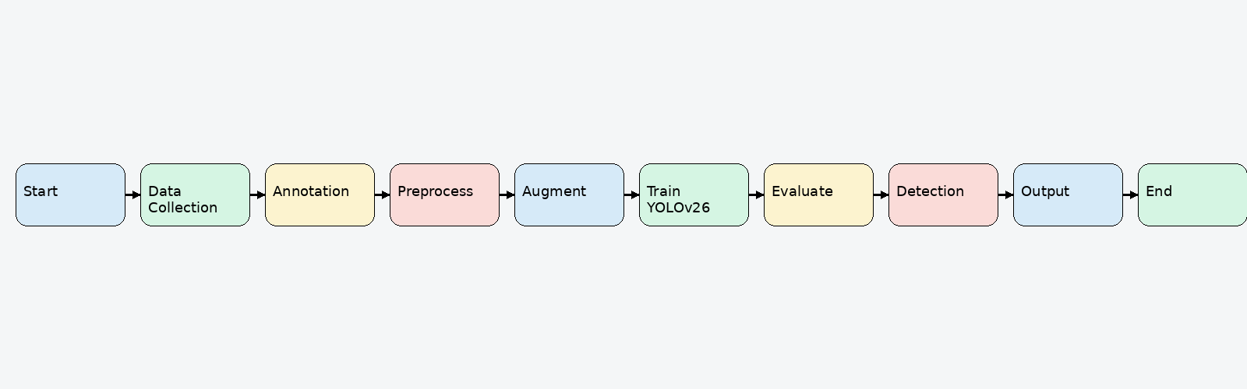
SYSTEM WORKFLOW
Data Collection → Annotation → Preprocessing
Augmentation → Training → Evaluation → Prediction
Ensures structured and efficient pipeline.
Supports real-time detection.
This workflow ensures a structured process from raw data collection to real-time detection output.

Slide 9
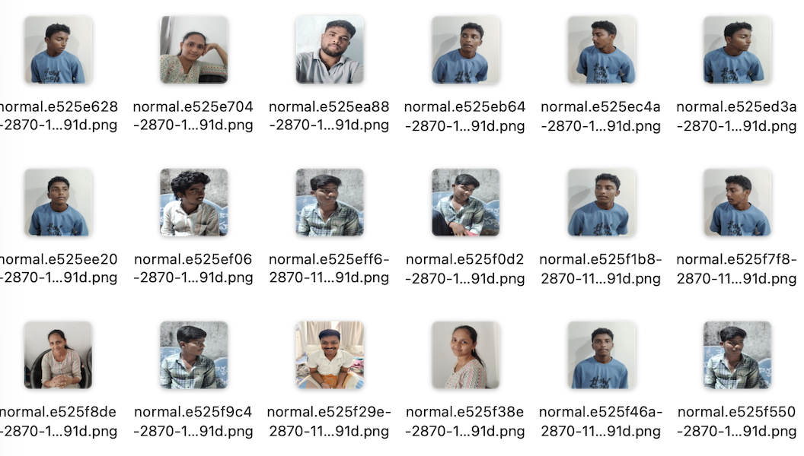
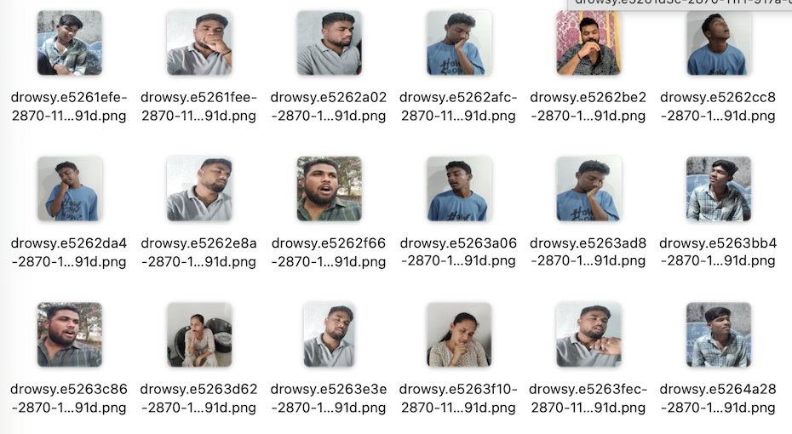
DATASET PREPARATION
Custom dataset with two classes: Normal and Drowsy.
Includes variations in lighting and head orientation.
Balanced dataset improves model performance.
Ensures better generalization.
A diverse dataset helps the model perform well in real-world conditions

Slide 10
DATA ANNOTATION
Annotation performed using LabelMe.
Bounding boxes applied to face regions.
Converted LableMe to YOLO Co-ordinates.
Labels assigned for classification.
Essential for YOLO training.
Annotation is essential for training YOLO, as it learns object location and classification.

Slide 11
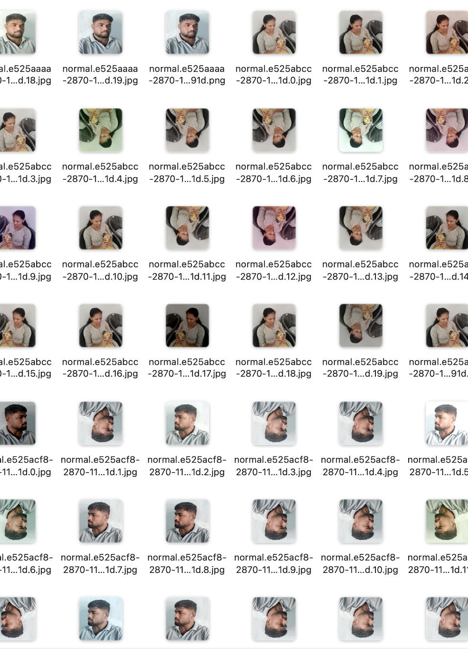
AUGMENTATION
Images resized to 640x640.
Normalization applied.
Augmentation techniques: flip, brightness, rotation.
Improves robustness and reduces overfitting.
Augmentation increases dataset diversity and reduces overfitting.

Slide 12
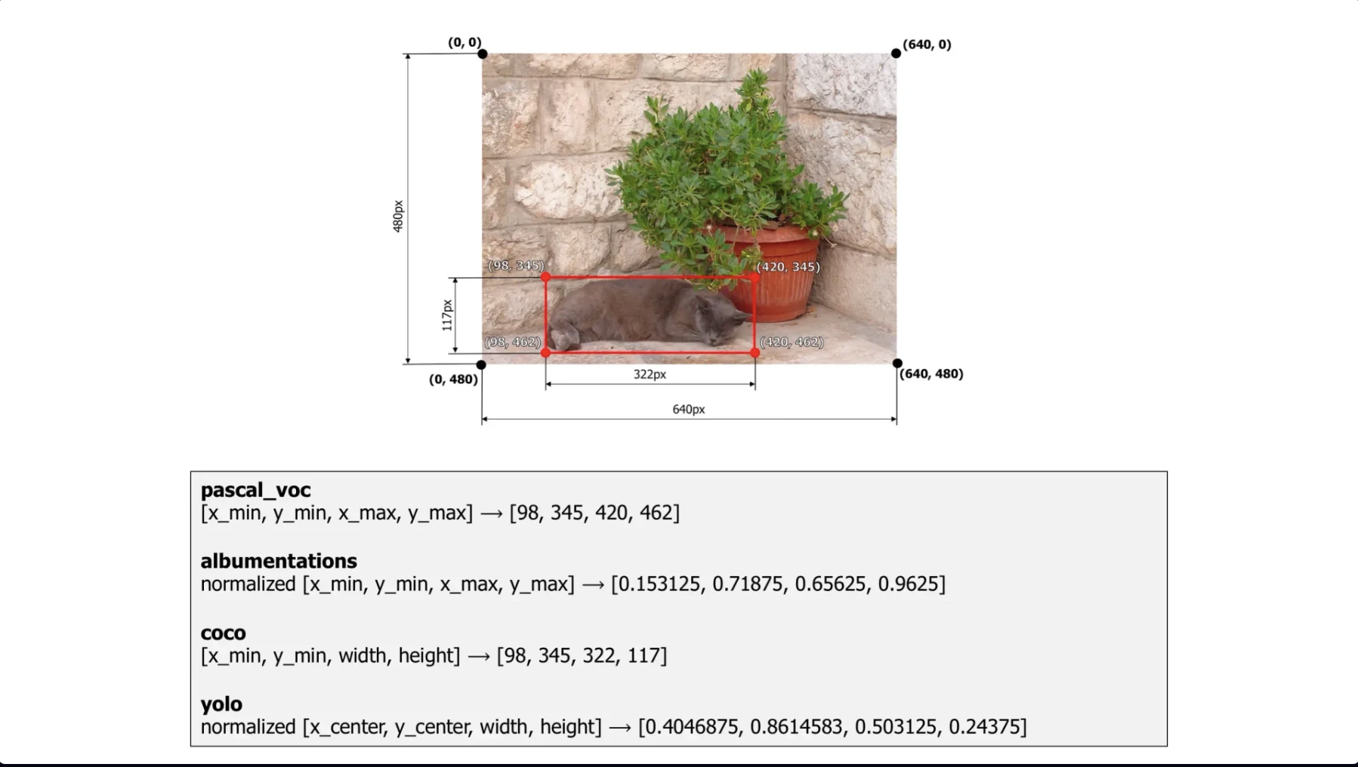
AUGMENTATION(contd.)

Slide 13
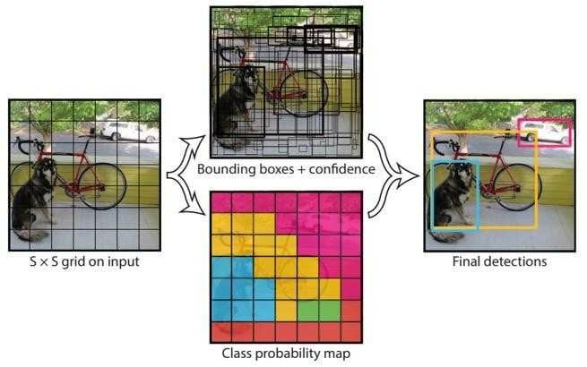
YOLO MODEL
Single-stage object detection model.
Predicts bounding boxes and class labels.
Processes image in a single forward pass.
Achieves low latency and high efficiency.
YOLO processes the entire image in one step, making it much faster than traditional models.

Slide 14
TECHNOLOGIES USED
Python for implementation.
OpenCV for real-time detection.
Ultralytics YOLO 26 for model training.
LabelMe for annotation.
NumPy and Matplotlib for processing and visualization.
These technologies together enable efficient model development and deployment

Slide 15
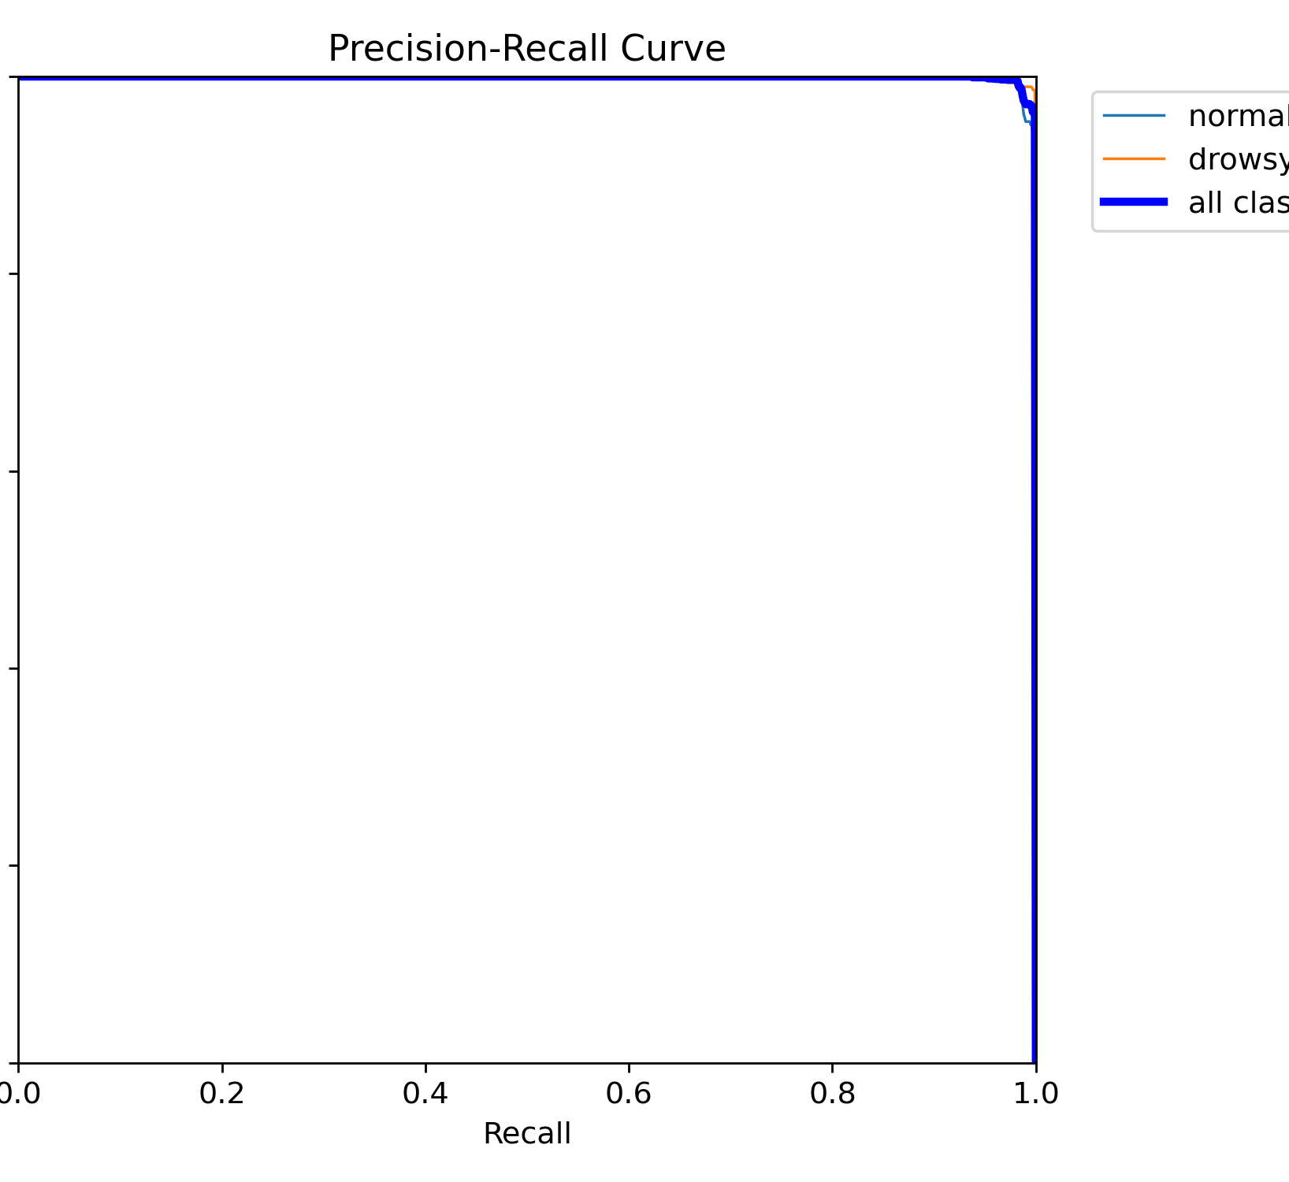
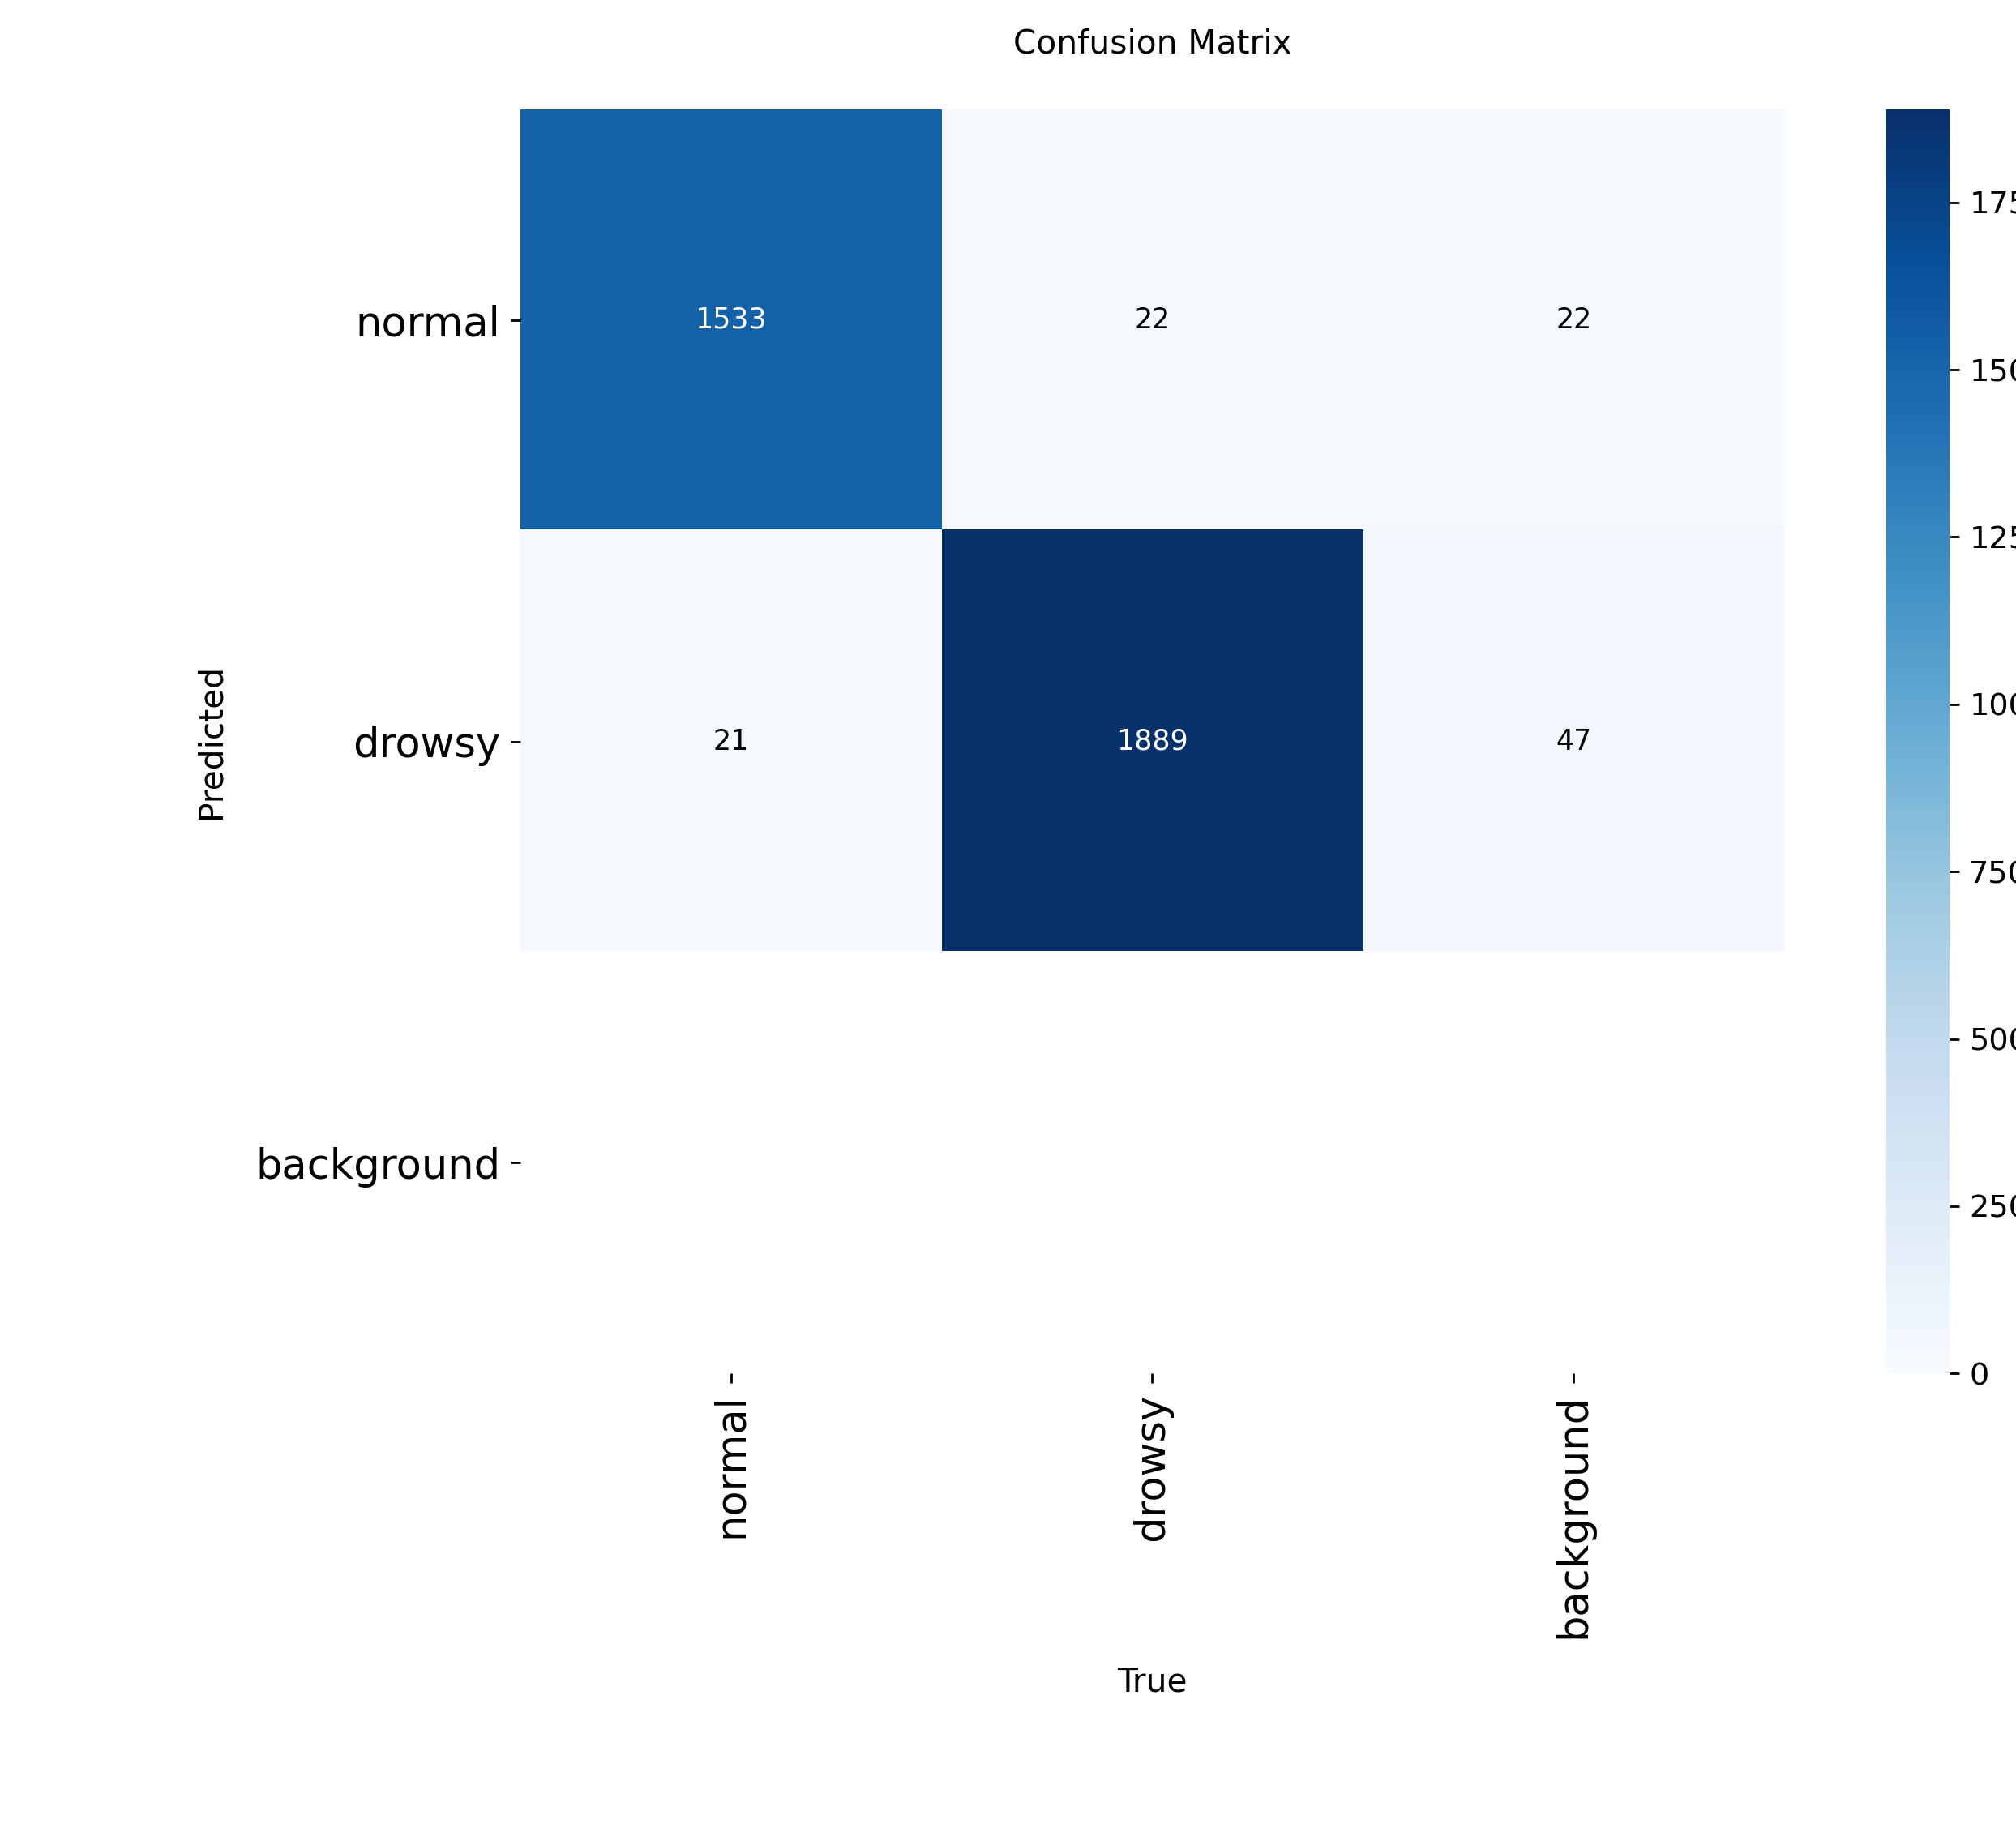
RESULTS
F1-score ≈ 0.99 indicating high accuracy.
mAP ≈ 0.995 showing strong detection performance.
Confusion matrix shows minimal misclassification.
Model generalizes well to unseen data.
The results show high accuracy and strong balance between precision and recall

Slide 16
CONTRIBUTION
Customized YOLOv26 model.
Improved real-time performance.
Reduced computational complexity.
Enhanced robustness using augmentation.
Suitable for real-world deployment.
The results show high accuracy and strong balance between precision and recall.

Slide 17
LIMITATIONS
Performance depends on dataset diversity.
Reduced accuracy in extreme conditions.
Only binary classification used.
No real-world deployment testing.

Slide 18
FUTURE WORK
Integration with real-time webcam systems.
Alert system for driver warning.
Multi-class detection (yawning, blinking).
Deployment on edge devices.
Improvement under challenging conditions.
Future improvements will enhance robustness and real-world applicability

Slide 19
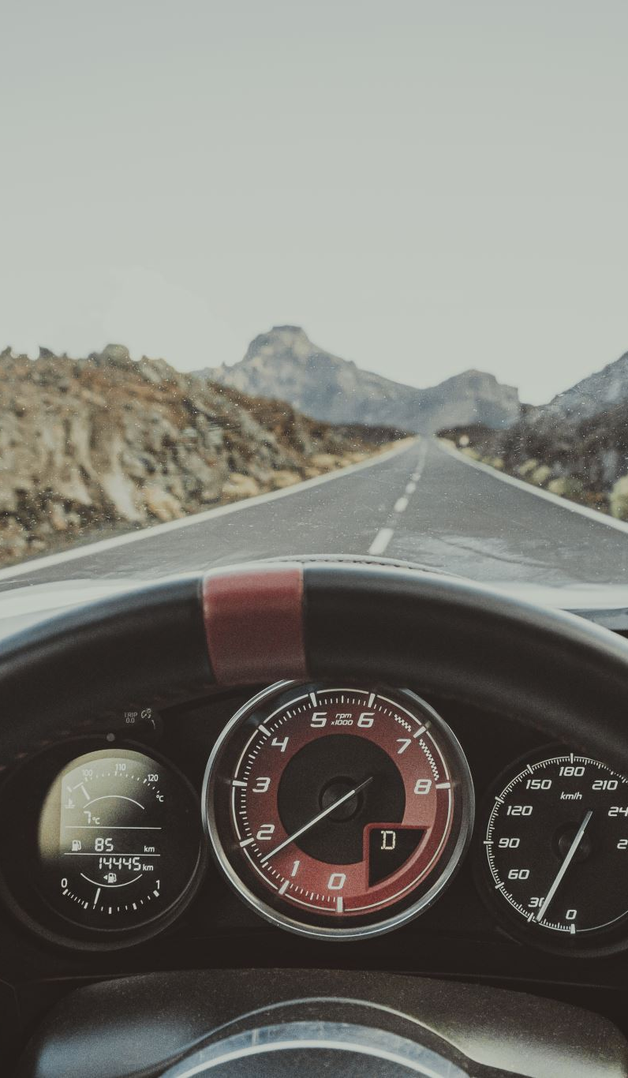
CONCLUSION
Developed a real-time driver drowsiness detection system.
Achieved high accuracy and efficiency.
Balanced performance and computational cost.
Demonstrates potential for improving road safety.
This project demonstrates how deep learning can improve road safety through real-time driver monitoring.

